Slide 1
Statewide Assessment NSCAS Rosters Maggie Sis November 10, 2021

Slide 2
NSCAS
NSCAS Growth
Previously the NSCAS General Assessment
New testing system has not been named yet
NSCAS Alternate Assessment
DRC/INSIGHT
Intended for Students with Most Significant Cognitive Disabilities (Typically About 1% or less of population)
NSCAS ACT Assessment
ACT/Pearson Next (PA Next)

Slide 3
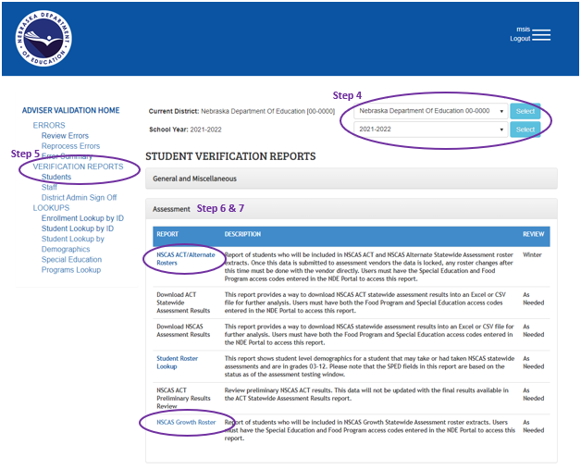
ADVISER Roster Reports
You may need to obtain the SPED & FRL codes from your district admin

Slide 4
NSCAS Roster Reports
PULLED FIELDS for | Alternate & ACT
REPORTING_SCHOOL | BIRTHDATE
MEMBERSHIP_SCHOOL | STUDENT_GENDER
GRADE | ETHNIC_CODE
ASSESSMENT | SPED
STUDENT_NAME | PRIMARY_DISABILITY
STUDENT_ID | EL
 | LOCK_DATE

Slide 5
NSCAS Growth Roster
ADVISER Data Requirements
Grade level 3 – 8
Full-time Equivalency (FTE) is 51% or higher
Alternate Assessment field coded “NO” in the SPED record
School of Accountability(School of Record) and School of Attendance (School of Membership)

Slide 6
NSCAS Alternate Assessment
ADVISER Data Requirements
Grade level 3 – 8 or 3rd-Yr High School Cohort (2023)
Full-time Equivalency (FTE) is 51% or higher
Alternate Assessment field coded “YES” in the SPED record

Slide 7
NSCAS ACT Assessment
ADVISER Data Requirements
3rd-Yr High School Cohort (2023)
Full-time Equivalency (FTE) is 51% or higher
Alternate Assessment field coded “NO” in the SPED record

Slide 8
ADVISER Rosters Reports
Exempt (Home)School Students
Your Superintendent should have access to the Exempt Schools – School District Report within the Data Collections area of the NDE portal for the status of submissions of the exempt (home) school students. You should also refer to the Status Description/Coding for Enrollment sheet that provides data coding guidelines; housed in the same area as the report. Once you see a “submitted” or “pending” status on the report the district can move forward with a 205 enrollment code in their SIS/SRS/ADVISER. With the 205 code and an effective date in ADVISER, this will remove the students from the assessment rosters.
External Program Students
Districts should be in direct contact with the Rule 18/ESU/Contracted Agencies to ensure your students attending these programs participate in NSCAS testing. In the January roster file, ensure they are listed under their school of record.

Slide 9
Contacts & Website
Maggie Sis, Assessment Program Coordinator
Margaret.Sis@nebraska.gov
531-739-8665
Iris Owens, ACT Onsite Liaison
Iris.A.Owens@act.org
531-207-9019
Statewide Assessment General Inquiries
nde.stateassessment@nebraska.gov
402-471-2495
Statewide Assessment Website
https://www.education.ne.gov/assessment/

Slide 10
QUESTIONS?

